Slide 1
OWASP and OWASP Top 10 (2007 Update)
Dave Wichers
The OWASP Foundation
OWASP Conferences Chair
dave.wichers@owasp.org
COO, Aspect Security
dave.wichers@aspectsecurity.com

Slide 2



About the Speaker
Background
IT Security Consultant for past 19 years
Focus on application security for past 9 years
Bachelor’s and Masters Degrees in Computer Science
CISSP, CISM
Aspect Security Founder and COO
Specialists in application security
Verify critical applications (~3 million LOC/month)
Enable companies to reliably produce secure code
OWASP Foundation
Coauthor of OWASP Top 10
Member of OWASP Board
Conferences Chair for OWASP AppSec Conferences
Established OWASP as 501c3 not-for-profit in U.S.
Dave Wichers
dave.wichers@aspectsecurity.com
301-604-4882

Slide 3
OWASP
The Open Web Application Security Project (OWASP)
International not-for-profit charitable Open Source organization funded primarily by volunteers time, OWASP Memberships, and OWASP Conference fees
Participation in OWASP is free and open to all

Slide 4

OWASP Mission
To find and fight the causes of insecure software

Slide 5
OWASP Body of Knowledge
Guidance and Tools for Measuring and Managing Application Security
Guide to Application Security Testing and Code Reviewing
Verifying App Security
Managing App Security
Guide to Building Secure Web Applications and Web Services
Core AppSec Knowledge Base
Projects
Chapters
AppSec Conferences
App Security Tools
Acquiring and Building Secure Apps
Tools for Scanning, Testing, Simulating, and Reporting Web App Security Issues
Research to
Secure New
Technologies
AppSec Education and
CBT
Research Projects to Figure Out How to Secure the Use of New Technologies (like Ajax)
Principles
Threat Agents, Attacks, Vulnerabilities, Impacts, and Countermeasures
OWASP Community Platform
(wiki, forums, mailing lists)
Web Based Learning Environment and Guide for Learning Application Security
OWASP Foundation 501c3
Notes:
Everything people need to understand and practice application security

Slide 6
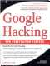
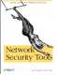
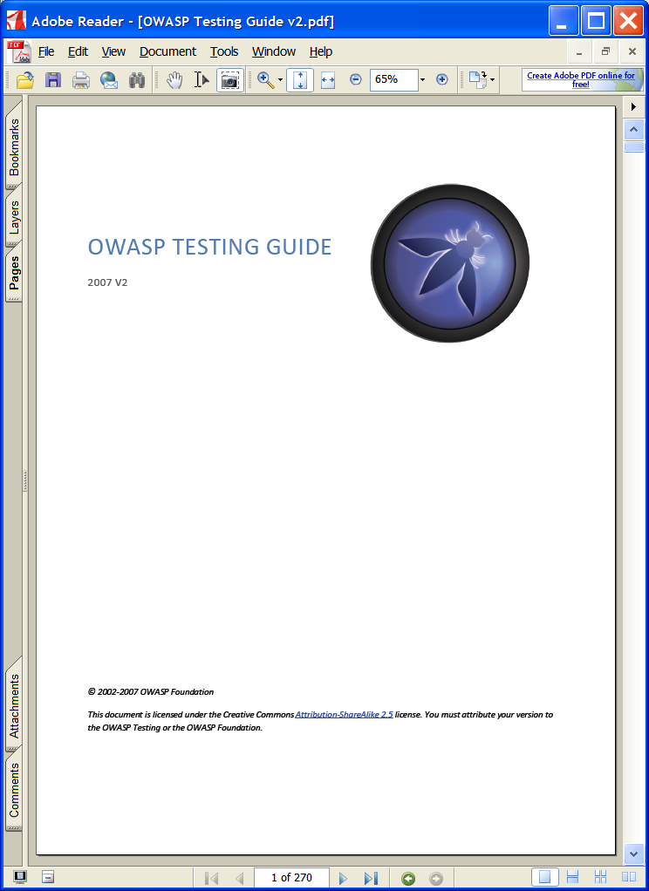
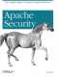
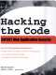
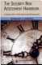
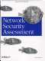


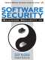
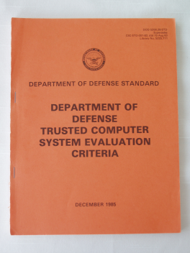


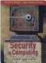

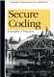
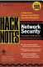
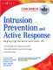

OWASP Projects are:
Alive on our wiki …
2009
2007
2005
2003
2001
Notes:
The Testing is alive…
When they say, “print is dead” they don’t mean it’s out of style – it’s static not living! Do you have a bookshelf of security books? When’s the last time you opened them? They don’t have answers to today’s problems because they’re dead.
It’s a process for translating security principles to the latest technologies and getting them to developers fast
It’s an evolving growing living thing

Slide 7
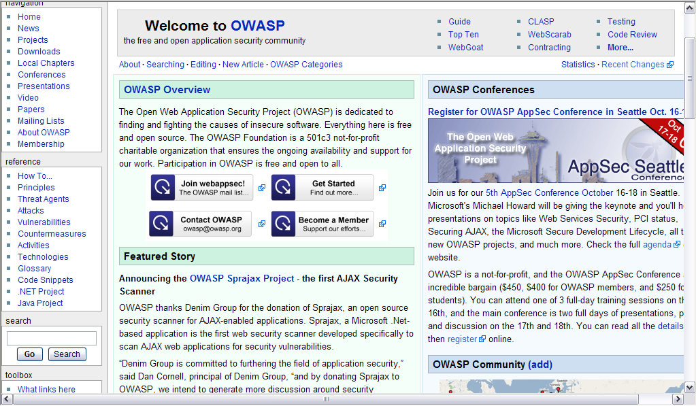
www.owasp.org (our wiki)

Slide 8
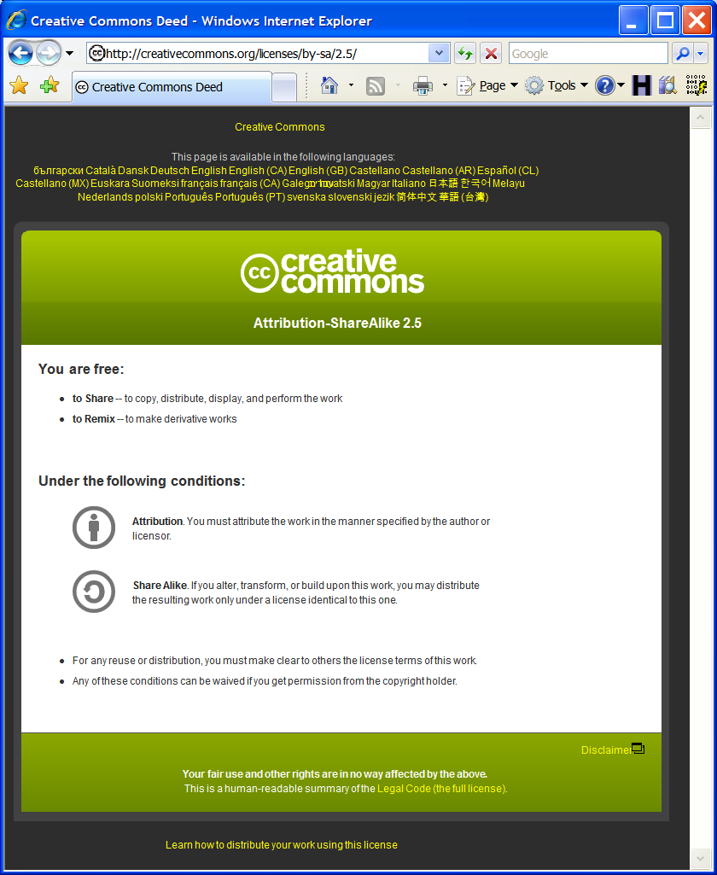

What Is Unique about OWASP?
Everything we do is free and open…
Notes:
Freedom
Free as in “free beer” is important to reach enough people
Free as in “free speech” is important so nobody can ever take it away
Anyone and everyone can participate and contribute
OWASP is not about recognition – it represents a collective work
Security shouldn’t be a black art

Slide 9

Why OWASP? Attacks Shift Towards Application Layer
Security
Spending
% of Attacks
% of Dollars
Web
Applications
10%
75%
90%
Network Server
25%
2/3
of All Web Applications Are Vulnerable
Sources: Gartner, Watchfire
Notes:
Main Point
Attacks have shifted from the network to the application layer, and so should spending
Teaching Points
Gartner has found that only 25% of the attacks are targeting the network layer, and the other 75% has shifted focus onto the application layer.
So, we’ve invested in protecting our network and platform, but the attacks have shifted to the soft center.
The problem in industry is that security spending has not also shifted to the application layer to counter the upsurge in attacks.
Examples, Demonstrations, Stories, Notes

Slide 10


Problem Illustration
Application Layer
Attacker sends attacks inside valid HTTP requests
Your custom code is tricked into doing something it should not
Security requires software development expertise, not signatures
Network Layer
Firewall, hardening, patching, IDS, and SSL cannot detect or stop attacks inside HTTP requests.
Security relies on signature databases
Finance
Transactions
Accounts
Administration
Communication
Knowledge Mgmt
E-Commerce
Bus. Functions
Databases
Legacy Systems
Web Services
Directories
Billing
Application Layer
Human Resrcs
APPLICATION ATTACK
Custom Code
App Server
Web Server
Hardened OS
Network Layer
Firewall
Firewall
Insider
Notes:
Main Point
Application layer security works differently from network security.
Teaching Points
Network security is about firewalls, IDS, SSL, hardening, and patching. Most network security relies on databases of vulnerability signatures that are used for scanning and detecting attacks. Patch management is the only solution to keeping systems secure. But applications are different. There are no signature databases for company’s custom software. Scanning and intrusion detection do not work nearly as well at the application layer.
Network security is still very important, but app security is equally important, and deserves equal funding and attention. No existing security technology protects applications from malicious attacks. Firewalls allow attacks through HTTP ports (80/443). Intrusion Detection Systems only detect attacks against known holes. Hardening allows attacks through HTTP ports (80/443)
Even SSL does very little to protect applications. While SSL protect users from getting their traffic sniffed, it ironically protects the hacker’s attacks on an application. Essentially, SSL creates a secure tunnel to the application and allows everything through.
Applications are the low-hanging fruit for attackers. Data shows that applications are under attack. Gartner says 70% of application traffic is attack traffic.
Examples, Demonstrations, Stories, Notes
Mention the SANS study that shows that unprotected hosts are generally compromised in less than 15 minutes.

Slide 11
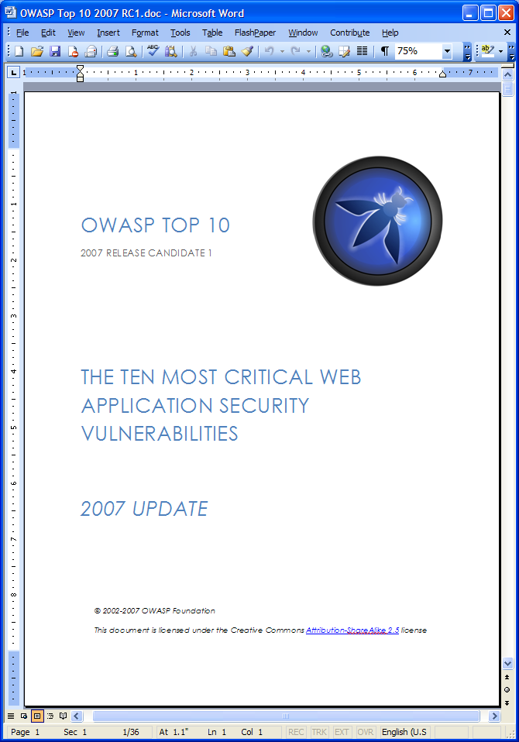
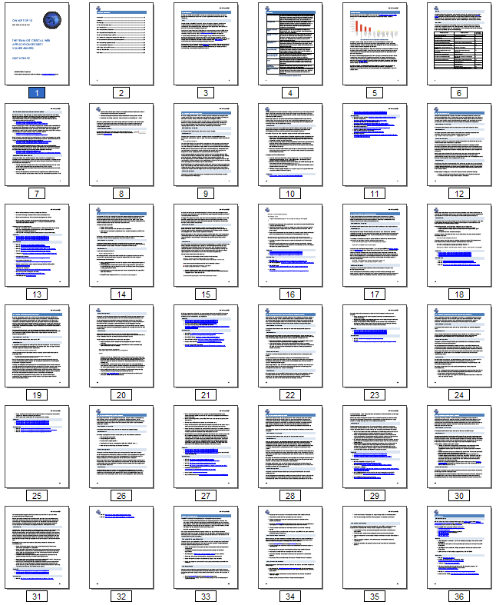
What is the OWASP Top 10?
The first (but not only) things you should focus on …
http://www.owasp.org/index.php/Top_10
Notes:
Facts about the DOCUMENT:
Free PDF file and website
270 pages
Basic guideline for performing web application security testing
Covers the most serious attacks and vulnerabilities
Sort of an encyclopedia of testing procedures
Not complete…more on this later

Slide 12
OWASP Top Ten – 2007 Update
Release Candidate 1 – Undergoing internal review
Will be made public by March 2007
A1: Cross Site Scripting (XSS)
A2: Injection Flaws
A3: Malicious File Execution
A4: Insecure Direct Object Reference
A5: Cross Site Request Forgery (CSRF)
A6: Information Leakage and Improper Error Handling
A7: Broken Authentication and Session Management
A8: Insecure Cryptographic Storage
A9: Insecure Communications
A10: Failure to Restrict URL Access
RC1: http://www.owasp.org/index.php?title=Top_10_2007
Notes:
Main Point
The OWASP Top Ten identifies the 10 most critical flaws in Web Applications today.
Teaching Points
We cover all these topics, plus many more, in this course (so we don’t go over these topics now).
Most developers are not aware of the vulnerabilities because they have not been trained in security issues. We have found that if they are made aware of the problems they will gladly fix them. In fact, we have had developers run out of a class saying they had to go fix something.
Lockheed Martin’s 10 Application Security Design principles are based in part on the OWASP Top Ten.
Examples, Demonstrations, Stories, Notes
The document was organized like the SANS Top 10 for Windows and Unix.
You and your development team might be surprised at the many ways attackers have found to trick applications into doing unintended things.
Many times vulnerabilities in combination will result in a more complex attack

Slide 13
Mapping of OWASP Top 10 2007 to 2004
OWASP Top 10 2007 | OWASP Top 10 2004
A1. Cross Site Scripting (XSS) | A4. Cross Site Scripting (XSS)
A2. Injection Flaws | A6. Injection Flaws
A3. Insecure Remote File Include (NEW)
A4. Insecure Direct Object Reference | A2. Broken Access Control (split in 2007 T10)
A5. Cross Site Request Forgery (CSRF) (NEW)
A6. Information Leakage and Improper Error Handling | A7. Improper Error Handling
A7. Broken Authentication and Session Management | A3. Broken Authentication and Session Management
A8. Insecure Cryptographic Storage | A8. Insecure Storage
A9. Insecure Communications | Discussed under A10. Insecure Configuration Management
A10. Failure to Restrict URL Access | A2. Broken Access Control (split in 2007 T10)
 | A1. Unvalidated Input
 | A5. Buffer Overflows
 | A9. Denial of Service
 | A10. Insecure Configuration Management

Slide 14
A1. Cross-Site Scripting (XSS)
Occurs any time…
Raw data from attacker is sent to an innocent user
Raw data…
Stored in database
Reflected from web input (form field, hidden field, url, etc…)
Sent directly into rich JavaScript client
Virtually every web application has this problem
Try this in your browser – javascript:alert(document.cookie)

Slide 15
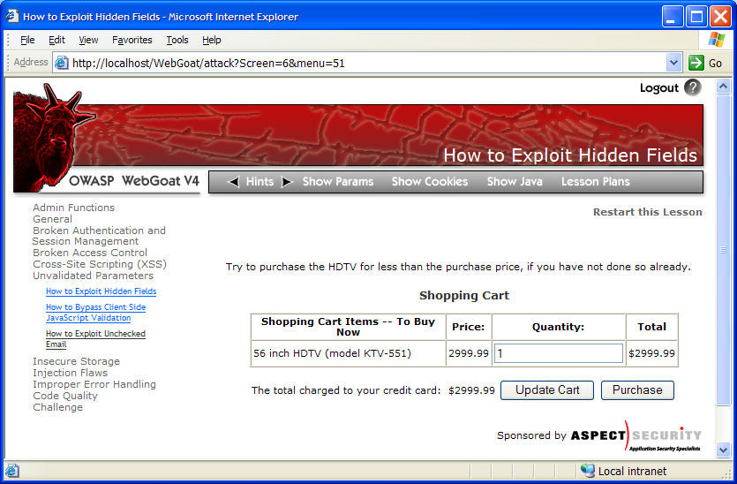
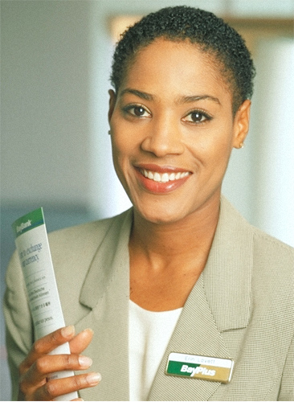
Cross-Site Scripting Illustrated
1
Attacker sets the trap – update my profile
Application with stored XSS vulnerability
Attacker enters a malicious script into a web page that stores the data on the server
2
Victim views page – sees attacker profile
Finance
Transactions
Accounts
Administration
Communication
Knowledge Mgmt
E-Commerce
Bus. Functions
Custom Code
Script runs inside victim’s browser with full access to the DOM and cookies
3
Script silently sends attacker Victim’s session cookie

Slide 16
A2. Injection Flaws
Injection means…
Tricking an application into including unintended commands in the data sent to an interpreter
Interpreters…
Take strings and interpret them as commands
SQL, OS Shell, LDAP, XPath, etc…
SQL injection is still quite common
Many applications still susceptible

Slide 17
SQL Injection Illustrated
1
Attacker sends data containing SQL fragments
Attacker enters SQL fragments into a web page that uses input in a query
3
Attacker views unauthorized data
Finance
Transactions
Accounts
Administration
Communication
Knowledge Mgmt
E-Commerce
Bus. Functions
Custom Code
2
Application sends modified query to database, which executes it
Database

Slide 18
A3: Malicious File Execution
Occurs when …
Attacker can influence an application to reference, upload, or create reference to a malicious file that gets executed
Example Scenarios
Very frequent flaw in PHP applications where untrusted variables are used in calls like include(), include_once(), require(), etc…
Application accepts name of file to execute as (usually hidden) input – attacker tampers with filename to execute unauthorized functions in file

Slide 19
PHP Remote File Include Illustrated
1
Attacker sends request that specifies the path to a malicious file in a parameter
Attacker enters SQL fragments into a web page that uses input in a query
Finance
Transactions
Accounts
Administration
Communication
Knowledge Mgmt
E-Commerce
Attacker views results of executing the attack
Bus. Functions
3
Custom Code
2
PHP application includes the specified file and executes the contents
File System

Slide 20
A4. Insecure Direct Object Reference
How do you protect access to data and other objects?
This is part of enforcing proper “authorization”, along with A10: Failure to Restrict URL Access
Frequently enforced by
Only listing the ‘authorized’ objects for the current user
Hiding the object references in hidden fields
This is called presentation layer access control, and doesn’t work
Attacker simply tampers with parameter value
For each parameter, a site needs to do 3 things
Verify the parameter is properly formatted
Verify the user is allowed to access the target object
Verify the requested mode of access is allowed to the target object (e.g., read, write, delete)

Slide 21
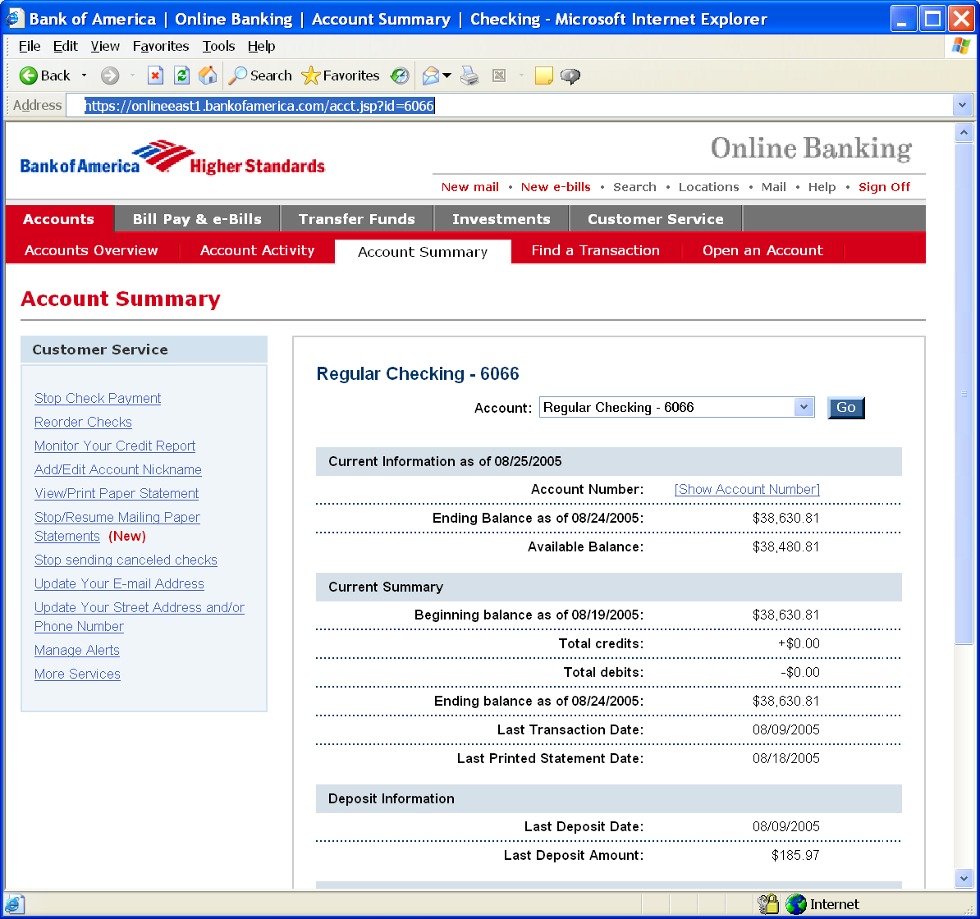
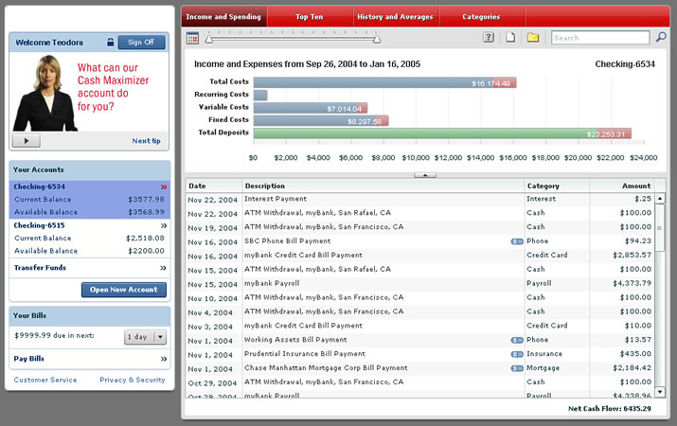
Insecure Direct Object Reference Illustrated
Attacker notices his acct parameter is 6065
?acct=6065
He modifies it to a nearby number
?acct=6066
Attacker views the victim’s account information
https://www.onlinebank.com/user?acct=6065
Notes:
Main Point
Here’s a concrete example of an access control problem to ensure that everyone understands what access control means.
Teaching Points
In this example, the attacker is simply manipulating the account id on the URL. The application should be getting the user’s account from a trustworthy source, not the user’s request.
There are many variations of this kind of attack. Many times they are not this obvious, relying on a hidden field, cookie, or header to make the access control decision. But the root cause is the same – never rely on anything from the user when making an access control decision.
Examples, Demonstrations, Stories
A healthcare application that processes xray and other medical imagery recently had this issue. They set a cookie called “privLevel” and used it to determine which functions to display. When we changed it from 4 to 10, we were given an administrator menu and could access many powerful unauthorized functions.

Slide 22
A5. Cross Site Request Forgery
Cross Site Request Forgery (CSRF)
An attack where the victim’s browser is tricked into issuing a command to a vulnerable web application
Imagine…
What if a hacker could steer your mouse and get you to click on links in your online banking application?
What could they make you do?
Attackers can use CSRF to…
Initiate transactions (transfer funds, logout user, close account, etc…)
Access sensitive data
Change account details
And much more…
Notes:
Main Point
CSRF is essentially an attack that essentially allows the attacker to drive your (the victim’s) browser. Wouldn’t that be bad? Of course. Its REALLY bad.
Teaching Points
CSRF attacks primarily target functions that cause state to change on the application. I.e., modify or delete something, initiate a transaction, etc.
However, CSRF attacks can simply be used to access sensitive data, and then transfer that sensitive data to the attacker.
Examples, Demonstrations, Stories

Slide 23
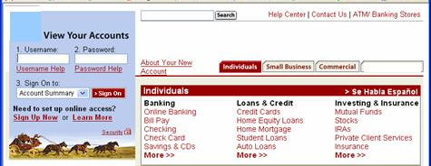
CSRF Illustrated
Attacker sets the trap on some website on the internet (or simply via an e-mail)
1
Application with CSRF vulnerability
Hidden <img> tag contains attack against vulnerable site
Finance
Transactions
Accounts
Administration
Communication
Knowledge Mgmt
E-Commerce
Bus. Functions
2
While logged into vulnerable site, victim views attacker site
Custom Code
3
Vulnerable site sees legitimate request from victim and performs the action requested
<img> tag loaded by browser – sends GET request (including credentials) to vulnerable site
Notes:
Main Point
This is how a CSRF attack works.
Teaching Points
1. Attacker lures victim to read some malicious content (in web site or e-mail)
2. Malicious request automatically sent to vulnerable site (if in IMG tag or something similar), or user might actually click on or submit something to initiate the request (i.e., phishing like attack).
3. IF THE CONDITIONS ARE RIGHT, then the malicious request will include the victim’s credentials when sent to the vulnerable site. If it works, the unauthorized transaction will be accepted, or the unauthorized request will return sensitive data to the attacker.
4. Regardless of success or failure of the attack, the attack itself is typically completely invisible to the potential victim.
Examples, Demonstrations, Stories

Slide 24
A6. Information Leakage and Improper Error Handling
Web applications leak information and encounter error conditions
Frequently this invokes untested code paths
Attackers learn about your application through error messages
Identify attacks and handle appropriately
Never show a user a stack trace
If someone is attacking you, don’t keep trying to help
But how do you know which errors are attacks?
Most web applications are quite fragile
Especially when you use a tool like WebScarab

Slide 25
Improper Error Handling Illustrated
Many security mechanisms fail open
isAuthenticated()
isAuthorized()
isValid()
Bad logic
if (!security_test())
then return false
return true
Good logic
if (security_test())
then return true
return false
java.io.FileNotFoundException: fred.txt at java.io.FileInputStream.<init>(FileInputStream.java) at java.io.FileInputStream.<init>(FileInputStream.java) at ExTest.readMyFile(ExTest.java:19) at ExTest.main(ExTest.java:7)
[Microsoft][ODBC Microsoft Access Driver] Syntax error in string in query expression 'last_name = 'bob' or foo''.

Slide 26
A7. Broken Authentication and Session Mgmt
HTTP is “stateless” protocol
Means credentials have to go with every request
Should use SSL for everything requiring authentication
Session management
SESSIONID used to track state since HTTP doesn’t
SESSIONID is just as good as credentials to an attacker
Never expose SESSIONID on network, in browser, in logs, …
Beware the side-doors
Change my password, remember my password, forgot my password, secret question, logout, email address, etc…

Slide 27
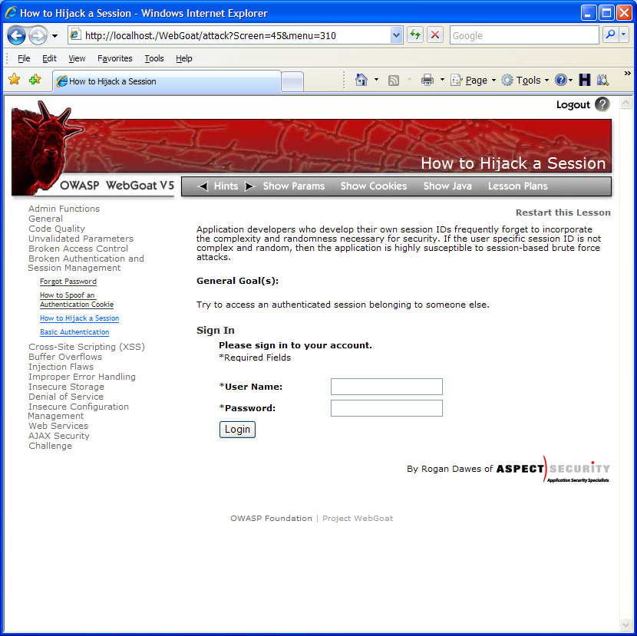
Broken Authentication Illustrated
1
User sends credentials
Finance
Transactions
Accounts
Administration
Communication
Knowledge Mgmt
E-Commerce
www.boi.com?JSESSIONID=9FA1DB9EA...
Bus. Functions
Site uses URL rewriting
(i.e., put session in URL)
2
Custom Code
3
User clicks on a link to http://www.hacker.com in a forum
Hacker checks referer logs on www.hacker.com
and finds user’s JSESSIONID
4
5
Hacker uses JSESSIONID and takes over victim’s account

Slide 28
A8. Insecure Cryptographic Storage
Storing sensitive data insecurely
Identify all sensitive data
Identify all the places that sensitive data is stored
Databases, files, directories, log files, backups, etc.
Protect with appropriate mechanisms
File encryption, database encryption, data element encryption
Use the mechanisms correctly
Use standard strong algorithms
Generate and protect keys
Be prepared for key change

Slide 29
Insecure Cryptographic Storage Illustrated
Victim enters credit card number in form
1
Finance
Transactions
Accounts
Administration
Communication
Knowledge Mgmt
E-Commerce
Bus. Functions
Custom Code
Malicious insider steals 4 million credit card numbers
Log files
4
Error handler logs CC details because merchant gateway is unavailable
2
Logs are accessible to all members of IT staff for debugging purposes
3

Slide 30
A9. Insecure Communications
Transmitting sensitive data insecurely
Identify all sensitive data
Identify all the places where sensitive data is sent
On the web, backend databases, business partners, internally
Protect with appropriate mechanisms
Use SSL on all connections with sensitive data
Individually encrypt messages before transmission
Use the mechanisms correctly
Use standard strong algorithms (disable old SSL alg.)
Manage keys/certificates properly
Use proven mechanisms when sufficient
E.g., SSL vs. XML-Encryption

Slide 31
Insecure Communications Illustrated
Business Partners
External Victim
Custom Code
Backend Systems
Employees
1
2
External attacker steals credentials and data off network
Internal attacker steals credentials and data from internal network
External Attacker

Slide 32
A10. Failure to Restrict URL Access
How do you protect access to URLs (pages)?
This is part of enforcing proper “authorization”, along with A4: securing direct object references
Frequently enforced by
Displaying only authorized links and menu choices
This is called presentation layer access control, and doesn’t work
Attacker simply forges direct access to ‘unauthorized’ pages
For each URL, a site needs to do 3 things
Restrict access to authenticated users (if not public)
Enforce any user or role based permissions (if private)
Completely disallow requests to unauthorized page types (e.g., config files, log files, source files, etc.)

Slide 33
Failure to Restrict URL Access Illustrated
Attacker notices the URL indicates his role
/user/getAccounts
He modifies it to another directory (role)
/admin/getAccounts, or
/manager/getAccounts
Attacker views more accounts than just their own

Slide 34
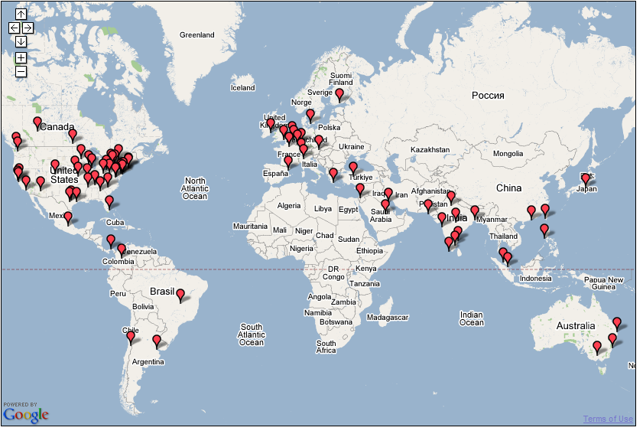
Join OWASP
The OWASP Spring of Code starts soon!
Notes:
OWASP Worldwide
5,000 chapter and project members around the world

